Slide 1


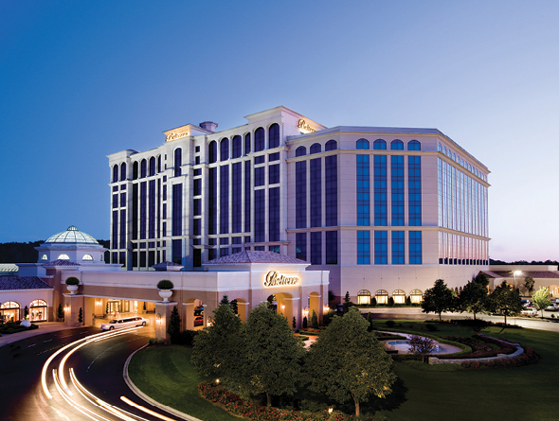
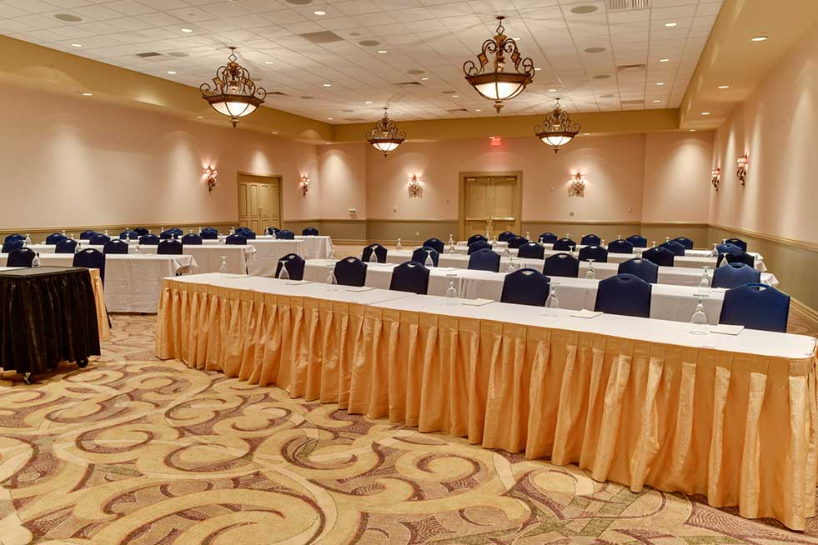
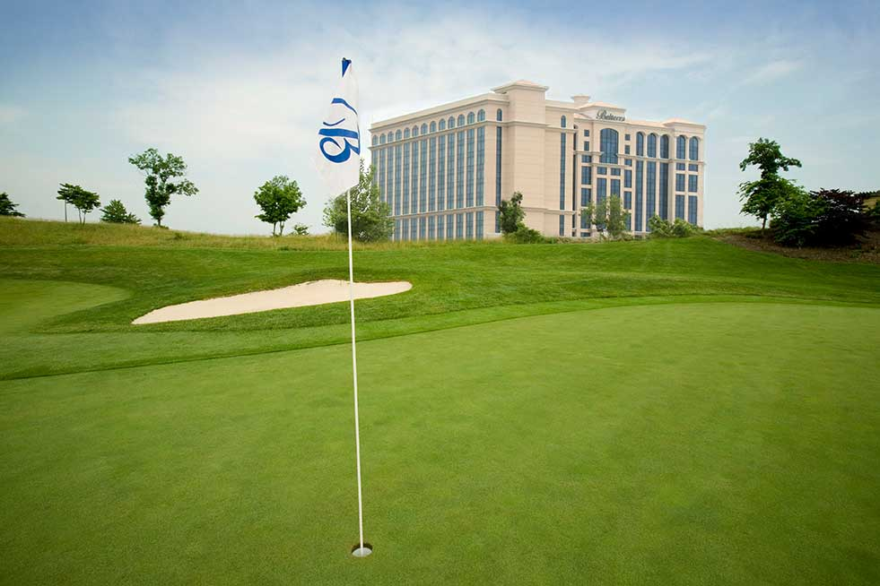
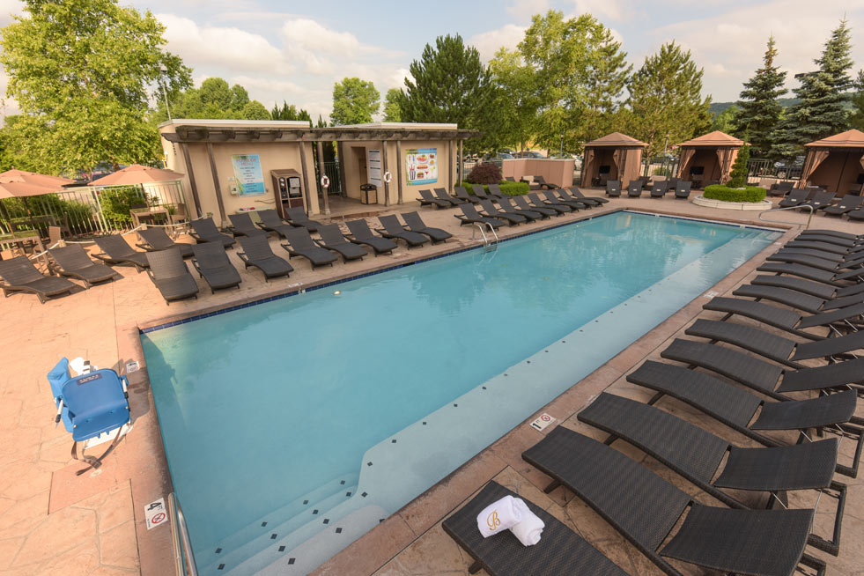
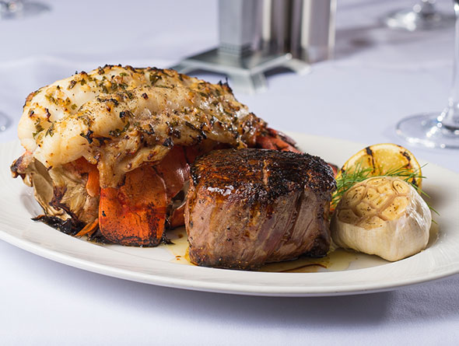

KAMC 2026 ANNUAL SUMMER MEETING
Thursday, July 30 – Friday, July 31
Agenda
Thursday, July 30, 2026
4:00 PM Board of Governors Meeting, Cedar Room All are welcome
5:00 PM Networking Reception, location TBA
6:30 PM KAMC Dinner, 19 Steak and Seafood, selected menu, cash bar
Friday, July 31, 2026
8:00 AM Breakfast Buffet, Cedar Room
9:00 AM KAMC Meeting
KAMC Board Update
SEVA Update
Kentucky Retail Federation Update
NAMA update
2026 – 2027 Scholarship winner(s) announcement
5-minute sponsor presentations
Group discussion – Are you ready for AI and the tech future?
1:00 PM Lunch Buffet, Cedar Room
2:00 PM Meeting Adjourn
Please Submit Meeting Registration by June 19
Click here for Meeting Registration Form
For Belterra room reservations please click the link below
https://book.passkey.com/e/51257753

